Slide 1

Three Step Security Provider Application( SPA )
Under Guidance of:
Dr. D. R. Ingle
Created By:
Pritam Padhye 38
Shruti Varade 67
Abhinav Walde 70

Slide 2
Contents:
Abstract
Methodology
Conclusion
Reference
Problem Statement
Introduction
Literature Survey

Slide 3
Abstracts
In todays world the applications are becoming smarter day by day and continuously play with the data in the application with this the need for providing security to the application as well as data is gaining importance.
The proposed System will provide and additional layer of security on the applications installed on the device. The proposed system will three option to authenticate the application using Single sign on algorithm.
This will also give features to select the application that will be operated with this system.
The proposed system will also provide features like Sign in using credentials and Graphical User Authentication or with OTP. The proposed system will not hamper the working of any application in turn provide additional security.

Slide 4
Introduction
Desktop application to provide three step security to an application installed in the desktop.
Application will use any of the three authentication systems
User will get updates on the smart phone related to activities on desktop.
Application will auto shut off after a specific time.

Slide 5



Literature Survey (Existing)

Slide 6
Literature Survey (Analysis)
 | SecProApp | LockApp (Microsoft) | AppLocker (Apple) | FSPro (Third Party)
Application Security | Yes | Yes | Yes | Yes
Auto Shutoff | Yes | No | Yes | Yes
Login | Yes | Yes | Yes | Yes
Graphical User Authentication | Yes | No | No | No
One Time Password | Yes | No | Yes | No
Updates on Phone | Yes | No | No | No
Log File Access | Yes | No | No | No
Startup Security | Yes | Yes | Yes | No

Slide 7
Problem Statement
How can we add the security to the installed application those have low security, or we have sensitive data on files
How can security be used with more user-friendly way

Slide 8
Methodology (Architecture)
Splash Screen
User Login
GUA / OTP
Application select
Application Usage
Graphical user authentication and one-time password
Normal username and password module
The opening screen of application
The view to select the application to run in sandbox
Using the secured application is proposed systems sandbox

Slide 9
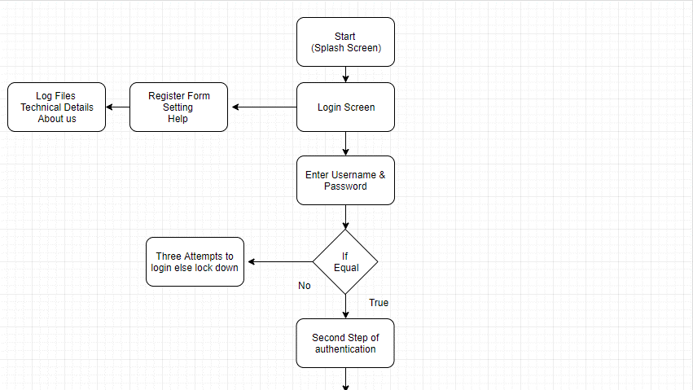
Methodology (Project Work-Flow)

Slide 10
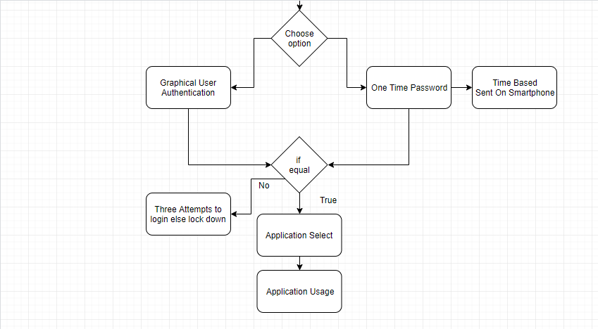
Methodology (Project Work-Flow)

Slide 11
Methodology (Algorithms used)
Sr. No. | Module | Algorithm
1. | Login | Database connectivity (C#)
2. | Graphical User Authentication | Recall Based GUA
3. | One Time password | Text Local API
4. | Log File | File Writer (C#)
5. | Updates | Text Local API
6. | Application Sandbox | Sandboxing (C#)
7. | Database | Microsoft SQL Lite

Slide 12
Conclusion
The Proposed system will be a useful and a must have application for the network connected computers or even mobile computers (laptop).
We have Completed the assured functionalities and workings of the proposed system

Slide 13
References
Online References | Research Papers References
www.ieeeexplorer.com | A study on web application security and detecting security vulnerabilities
www.Wikipedia.com | Mobile Application Security.
www.C#corner.com | A desktop application of QR code for data security and authentication

Slide 14
Thank You

